Slide 1
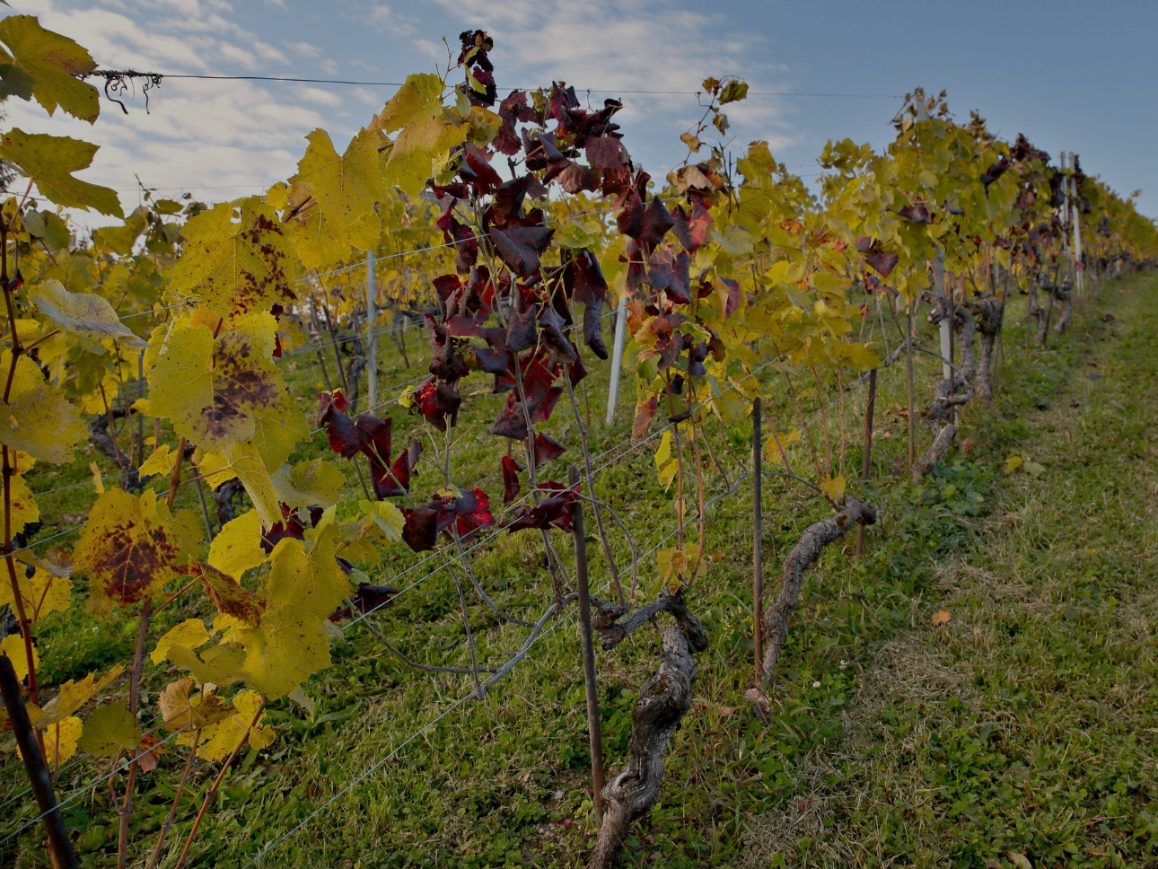
Flavescence Dorée
Specific management of FD
This project has received funding from the European Union's Horizon 2020 research and innovation programme under grant agreement N°652601

Slide 2
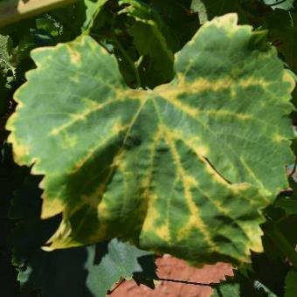
Flavescence Dorée
What is it?
Flavescence dorèe is a disease widely spread caused by a phytoplasma, a microorganism that lives inside of the plant, usually it does not kill the vine but it does obstruct the lymph path and alters the plant metabolism.

Slide 3
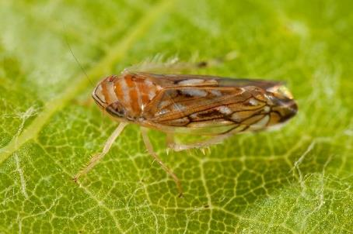
Flavescence Dorée
What is it?
The FD phytoplasma is transmitted plant to plant by an insect, schapoideus titanus, that feeds on the vine’s lymph; once a plant gets infected it can never heal.

Slide 4
Flavescence Dorée
Video-clip

Slide 5
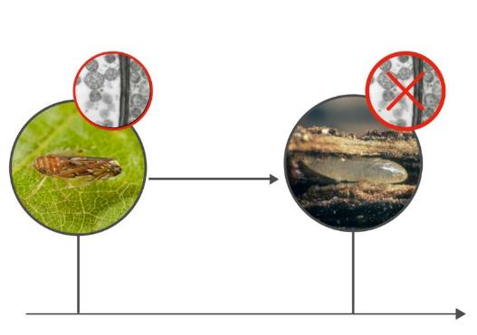
Flavescence Dorée
How to manage FD
Having in mind that ST has just one generation per year, and that the Phytoplasma is not passed down to the next ST generations

Slide 6
Flavescence Dorée
How to manage FD
Is possible to manage Flavescence Dorée only if those 4 practices are adopted:
The new plants do not have to be infected
The fight against the vector insect
Prospection activities
Uprooting infected plants

Slide 7
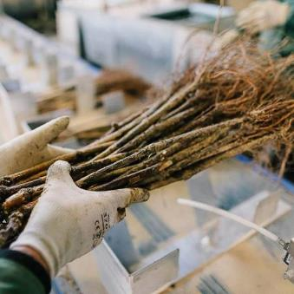
Flavescence Dorée
Vine plantation
The new plants do not have to be infected.
Since the FD phytoplasma is heat-sensitive the nurseries are starting to make an hot water treatment on the new plants.
This treatment guarantees non infected plants.

Slide 8
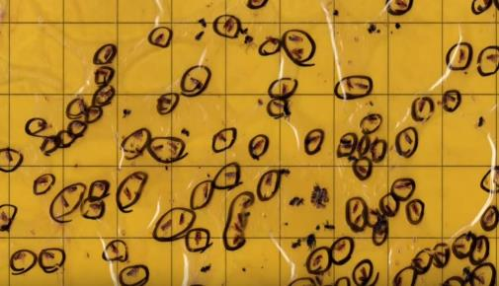
Flavescence Dorée
Fight against the vector
The fight against the vector insect Scaphoideus titanus is key to a successful FD management.

Slide 9
Flavescence Dorée
Video-clip

Slide 10
Flavescence Dorée
Fight against the vector
In order to be successful with the insecticide treatment is important to monitor the insect population, the most common ways are:
Emerging cages
Modelling
Monitoring of nymphal development stages
Monitoring adult with traps

Slide 11
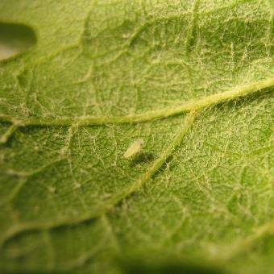
Flavescence Dorée
Emerging cages
These cages are a very effective tool to determine when Scaphoideus titanus first hatching appears. Two years old wood, preferred for egg laying, from a plot where Scaphoideus titanus presence was detected in the previous year are kept in a cage and hatching moment is monitored every day.

Slide 12
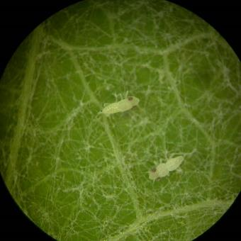
Flavescence Dorée
Emerging cages
A sticky trap is put inside the cage in order to capture nymphs as soon as they hatch.
When date of first hatching is determined the effective date for first insecticides treatment is positioned one month later.

Slide 13
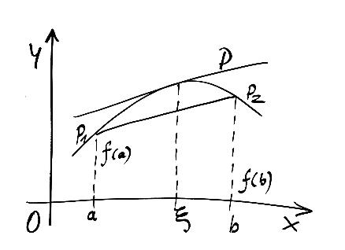
Flavescence Dorée
Modelling
Decision support systems exists and are able to predict in vineyard pests and diseases, including Scaphoideus titanus. One model currently in development can predict when each stage of Scaphoideus titanus nymphs will appear according to specific climatic conditions.

Slide 14
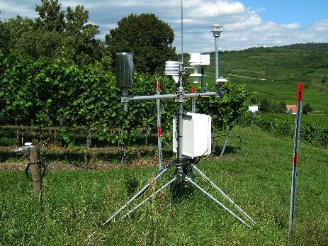
Flavescence Dorée
Modelling
Model is based on observations made the years before and historical and daily temperatures. In order to provide a more accurate possible real observation data on stages need to be informed.

Slide 15
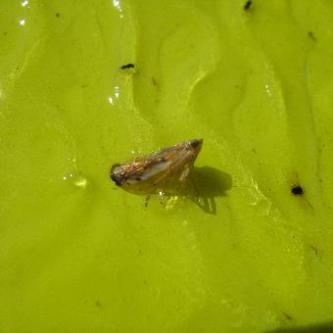
Flavescence Dorée
Monitoring adult with traps
Yellow sticky traps can be set up in vine-plot and can be monitored by growers themselves if properly instructed, or by specialists. Traps will help to decide when apply adulticide treatment. Adult flights have been often observed from the beginning of July to later than expected (October).

Slide 16
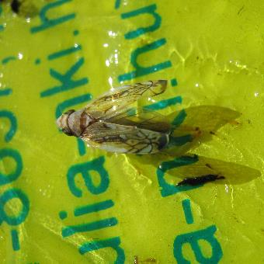
Flavescence Dorée
Monitoring adult with traps
The late control of vector leafhopper population is important to decide the opportunity of an additional insecticide against adults.

Slide 17
Flavescence Dorée
Fight against the vector
According to the region and to the population of ST, different treatment strategies could be adopted:
2 Treatment strategy
3 treatment strategy
4 treatment strategy

Slide 18
Flavescence Dorée
Fight against the vector
Two treatments strategy:
This strategy is adopted when the presence of ST and of the infected plants are low.
The 1st treatment is made 1 month after hatching
The 2nd is done on the adult population.

Slide 19
Flavescence Dorée
Fight against the vector
Three treatments strategy:
This is a strategy used in moderately infected vineyard
The 1st treatment is done one month after hatching
The 2nd at the end of the remanence of the 1st treatment (or on the adults)
The 3rd on the adults

Slide 20
Flavescence Dorée
Fight against the vector
Four treatment strategy:
This strategy is adopted in highly infected vineyards
1st treatment is done before flowering
2nd on the nymphs
3rd at the end of the previous treatment remanence
4th on the adults

Slide 21
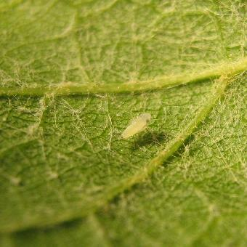
Flavescence Dorée
Fight against the vector
Without any treatment Scaphoideus titanus population could increase up to 10.000 individuals per hectare

Slide 22
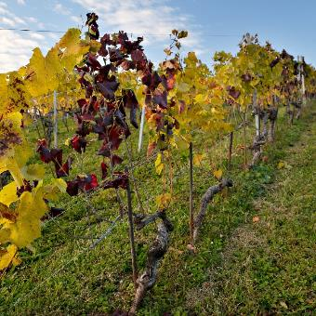
Flavescence Dorée
Monitoring the vineyard
If ST feeds on an infected wine it becomes infective, for this reason monitoring the vineyard in order to scout infected plants is key to success for managing FD.

Slide 23
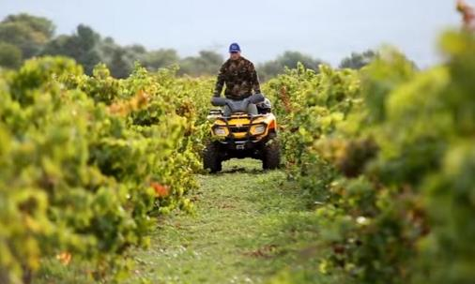
Flavescence Dorée
Monitoring the vineyard
The monitoring has to be done at least at individual vineyard scale; but monitoring at communal scale gives better results.

Slide 24
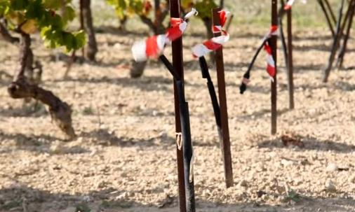
Flavescence Dorée
Uprooting infected plants
Once an infected plant has been scouted it has to be uprooted in order to stop disease spreading.

Slide 25
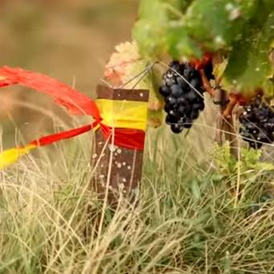
Flavescence Dorée
Uprooting infected plants
Uprooting or destruction of infected grapevines is suggested and mandatory in most of regions by national decree

Slide 26
Flavescence Dorée
Uprooting infected plants
During period of leafhopper presence (from May to August) as soon as an infected vine is detected it must be uprooted. The sooner an infected vine is uprooted, the better it is

Slide 27
Flavescence Dorée
Uprooting infected plants
If Scaphoideus titanus can’t feed on the infected vine, it won’t become infectious and won’t participate to disease’s propagation.

Slide 28
Flavescence Dorée
Uprooting infected plants
LEAVING INFECTED GRAPEVINES IN THE PLOT WILL INCREASE CONSIDERABLY INFECTION LEVEL IN THE COMING YEARS!

Slide 29
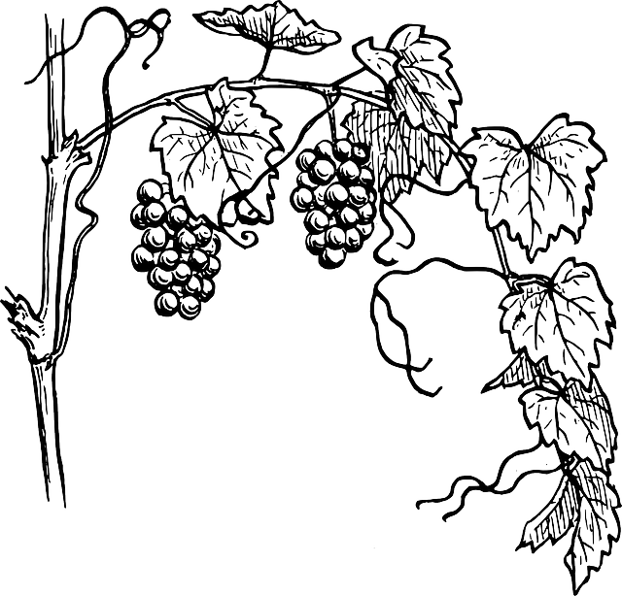
Flavescence Dorée
Wild vines management
Wild vines has both the Phytoplasma and the vector insect, though if a wild vine is infected it will not show symptoms.
For this reason is important both to fight the vector and to uproot the wild vines.

Slide 30
Flavescence Dorée
Wild vines management
The adults are the form that moves the most (up to more than 1 km), so is important not to manage the wild vines from May to October, because ST might migrate in a cultivated vineyard.

Slide 31
Flavescence Dorée
Wild vines management
IF SCAPHOIDEUS TITANUS CAN’T FEED ON THE INFECTED VINE, IT WON’T BECOME INFECTIOUS AND WON’T PARTICIPATE TO DISEASE’S PROPAGATION.

Slide 32
Flavescence Dorée
Quiz
Please answer to the given questions
Notes:
(15 minutes)

Slide 33
Flavescence Dorée
Quiz

Slide 34
Flavescence Dorée
Quiz
Results and Discussion

Slide 35
Flavescence Dorée
CREDITS
Vivai Fratelli Nicola
Ana Chiavari
Daniele Eberle
Agroscope
Viten
Andrea Lucchi
Chambre de’agriculture Bouches-du-Rhone

